Slide 1
Divvy Bike Challenge
Rajasekhar Reddy

Slide 2


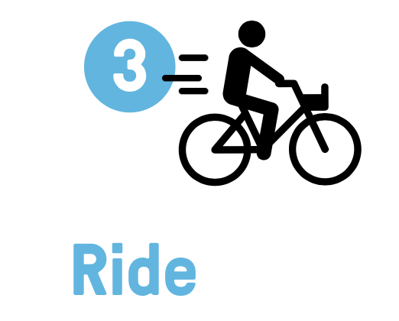


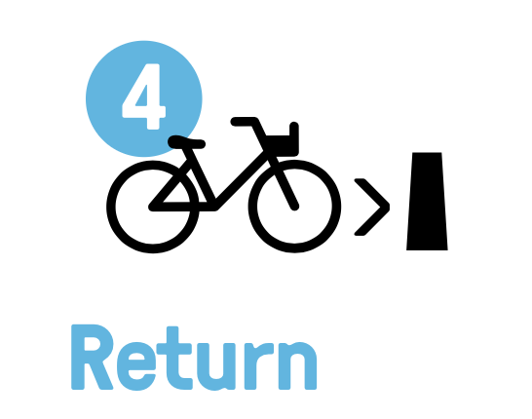
Why join Divvy?
Save time
Save Money
Have Fun
Get Exercise
Go Green

Slide 3
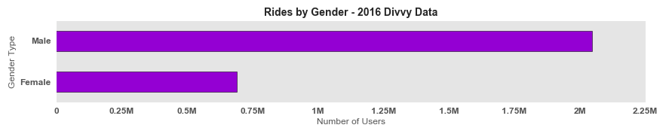
♂ - 2047174 (75%) ♀ - 689780 (25%)

Slide 4
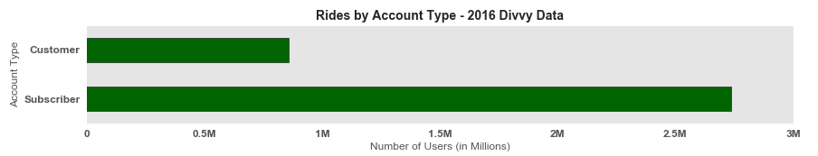
Subscriber – 2736869 (76%) Customer – 858474 (24%)

Slide 5
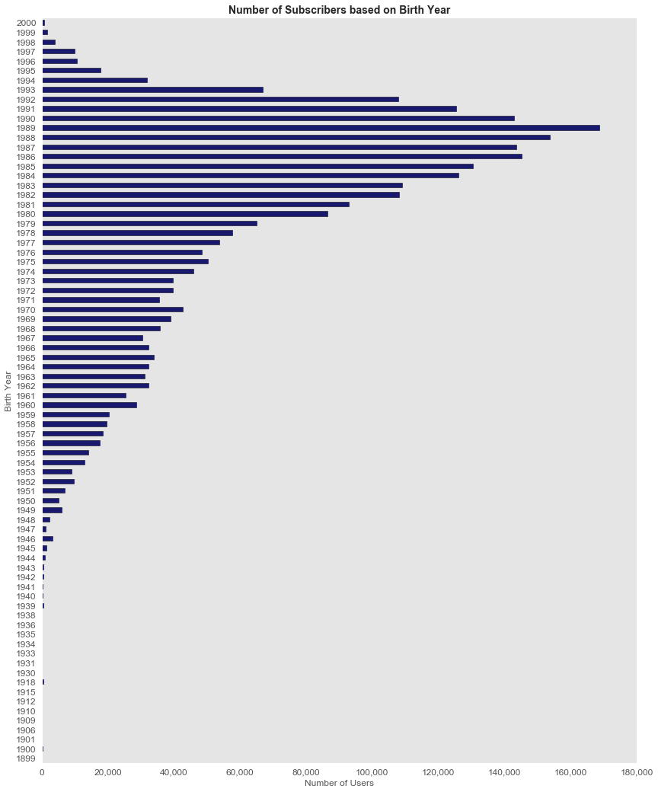
Subscribers count by Birth year
1989 born are the maximum number of subscribers in Divvy
Which age group rides Divvy bike a lot?
People from 1982 – 1992 age group are the most favorable people riding Divvy bikes.
These people fall into the 24 – 34 age bucket

Slide 6

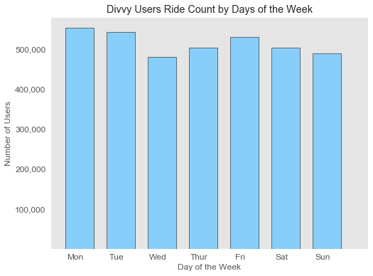
Count by Days of the week
Monday records the highest number of rides
Wednesday records lowest number of rides
The trend continues to be increased over the weekend gradually reducing after Saturday

Slide 7
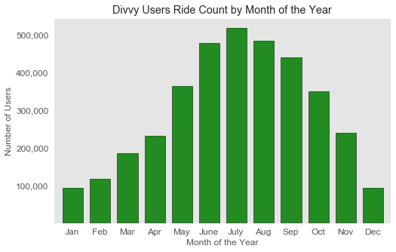
Count by Month of the Year
July is recorded with maximum number of users riding divvy bikes
June, July & August were the busiest months
January & December were seen the lowest

Slide 8
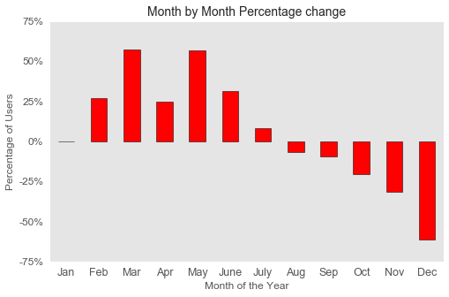
Percentage Change
Users are added more on the month of March as we enter the Spring Season.
Again May more users are riding bikes.
From July, number of people riding bikes are reduced below 25%.

Slide 9
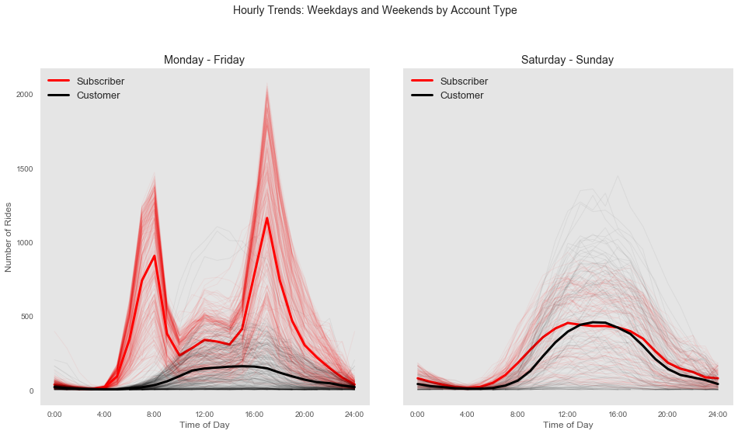
Hourly Trends
Weekday ridership peaks for members around the times a rider is likely to be heading to work or when returning home.
Casual ridership slowly rises in the morning and then remains relatively flat until eight p.m
Weekend ridership follows a similar basic normal distribution throughout the day for each type of user.

Slide 10
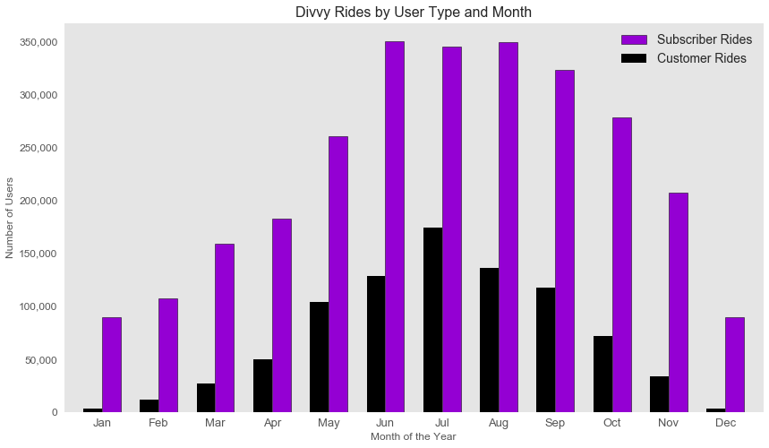
Rides by User Type & Month
June, July, August has steady growth cycle among the subscribers.
Customers rides were seen as normal distribution with July peaking maximum number of rides

Slide 11
Q&A
Thank You

